Slide 1
KNOWLEDGE MANAGEMENT (MIS 412) LECTURE 4 - KNOWLEDGE CREATION AND CODIFICATION
Iheanetu, O.U.

Slide 2
Objectives/ Goals
At the end of this lecture, students should understand -
What knowledge creation is and how knowledge is created
What Knowledge Codification Involves
Benefits of Knowledge Codification
Pre Knowledge Codification Questions
Tools and Procedures for knowledge Capturing and Codification
The Role of Planning

Slide 3
How is Knowledge Created?
Knowledge is created through practice, collaboration, interaction, and education, as the different knowledge types are shared and converted.
The creation of knowledge contributes to competitive advantage by providing organizations with a resource that is rare, valuable and inimitable.

Slide 4
What is Knowledge Creation?
Knowledge creation according to the Nonaka's SECI (Socialization, Externalization, Combination and Internalization) model is about continuous transfer, combination, and conversion of the different types of knowledge, as users practice, interact, and learn.
Knowledge creation is also supported by relevant information and data which can improve decisions and serve as building blocks in the creation of new knowledge.

Slide 5
What is Knowledge Creation? Cont’d
Knowledge creation is the formation of new ideas through interactions between explicit and tacit knowledge in individual human minds. As defined by Ikujiro Nonaka, it consists of socialization (tacit to tacit), externalization (tacit to explicit), combination (explicit to explicit), and internalization (explicit to tacit).

Slide 6
Knowledge creation as a process refers to the initiatives and activities undertaken towards the generation of new ideas or objects. As a process, it is defined in terms of the method or means through which knowledge is generated and can be differentiated from the end result, or output.
Knowledge creation as an output refers to the development of new ideas that reflect a significant elaboration or enrichment of existing knowledge. It is the difference between what is known and what must be known for project success. It describes an immediate product of the knowledge creation process, such as the representation of an idea.
Knowledge creation as an outcome means that new knowledge is diffused, adopted and embedded as new products, services and systems

Slide 7
Individual, Group & Organizational Knowledge Creation Process
Individual knowledge is shaped by personal experiences, through space and time, caused by relations with other individuals or, generally, with the nature of the environment, and that are processed by the human brain.
A group captures knowledge from its institutional (organizational level) and general environment. A group captures knowledge from its members’ contribution(s) through time and space. Observation, imitation, and practice shared between team members through the time shape, by means of socialization, a body of shared tacit knowledge, nor owned by any of the individuals nor owned by a shared property mod

Slide 8
How do Organizations create Knowledge?

Slide 9
Nonaka's Model of Knowledge Creation & Transformation
In 1995, Nonaka coined the terms tacit knowledge and explicit knowledge as the two main types of human knowledge. The key to knowledge creation lies in the way it is mobilized and converted through technology.
Tacit to Tacit communication (Socialization): Takes place between people in meetings or in team discussions. The socialization mode refers to conversion of tacit knowledge to new tacit knowledge through social interactions and shared experience among organizational members (e.g., apprenticeship).
Tacit to Explicit communication (Externalization): Articulation among people through dialogue. Externalization refers to converting tacit knowledge to new explicit knowledge (e.g., articulation of best practices or lessons learned, brainstorming).

Slide 10
Explicit to Explicit communication (Combination): This transformation phase can be best supported by technology. Explicit knowledge can be easily captured and then distributed/transmitted to worldwide audience. The combination mode refers to the creation of new explicit knowledge by merging, categorizing, reclassifying, and synthesizing existing explicit knowledge (e.g., literature survey reports).
Explicit to Tacit communication (Internalization): This implies taking explicit knowledge (e.g., a report) and deducing new ideas or taking constructive action. One significant goal of knowledge management is to create technology to help the users to derive tacit knowledge from explicit knowledge. Internalization refers to creation of new tacit knowledge from explicit knowledge (e.g., the learning and understanding that results from reading or discussion).
The four knowledge creation modes are not pure, but highly interdependent and intertwined

Slide 11
Some Knowledge Capturing Techniques
On-Site Observation (Action Protocol)
Brainstorming
Electronic brainstorming
Protocol Analysis (Think-Aloud method)
Consensus Decision making
Nominal Group Technique (NGT)
Delphi Method
Blackboarding

Slide 12
On-Site Observation (Action Protocol)
It is a process which involves observing, recording, and interpreting the expert's problem-solving process while it takes place.
The knowledge developer does more listening than talking; avoids giving advice and usually does not pass his/her own judgment on what is being observed, even if it seems incorrect.
Compared to the process of interviewing, on-site observation brings the knowledge developer closer to the actual steps, techniques, and procedures used by the expert.
One disadvantage is that sometimes some experts do not like the idea of being observed. It is expensive and time consuming.
The reaction of other people (in the observation setting) can also be a problem causing distraction.

Slide 13
Brainstorming
It is an unstructured approach towards generating ideas about creative solution of a problem which involves multiple experts in a session.
In this case, questions can be raised for clarification, but no evaluations are done at the spot.
Similarities (that emerge through opinions) are usually grouped together logically and evaluated by asking some questions like:
What benefits to be gained if a particular idea is followed?
What specific problems that idea can possibly solve.
What new problems can arise through this?

Slide 14
Brainstorming Cont.
The general procedure for conducting a brainstorming session:
Introducing the session.
Presenting the problem to the experts.
Prompting the experts to generate ideas.
Looking for signs of possible convergence.
If the experts are unable to agree on a specific solution, the knowledge developer may call for a vote/consensus.

Slide 15
Electronic Brainstorming
Is a computer-aided approach for dealing with multiple experts.
It usually begins with a pre-session plan which identifies objectives and structures the agenda, which is then presented to the experts for approval.
During the session, each expert sits on a PC and gets themselves engaged in a predefined approach towards resolving an issue, and then generates ideas.
This allows experts to present their opinions through their PC's without having to wait for their turn.
Usually the comments/suggestions are displayed electronically on a large screen without identifying the source.

Slide 16
Electronic Brainstorming
This approach protects the introvert experts and prevents tagging comments to individuals.
The benefit includes improved communication, effective discussion regarding sensitive issues, and closes the meeting with concise recommendations for necessary action
This eventually leads to convergence of ideas and helps to set final specifications.
The result is usually the joint ownership of the solution.

Slide 17
Protocol Analysis (Think-Aloud Method)
In this case, protocols (scenarios) are collected by asking experts to solve the specific problem and verbalize their decision process by stating directly what they think.
A protocol is a record or documentation of the expert’s step-by-step information –processing and decision-making behaviour.
Knowledge developers do not interrupt in the session, but listens and records the process. The elicited information is structured later when the knowledge developer analyzes and interprets the protocol into knowledge representation for review by the expert.
Here the term scenario refers to a detailed and somehow complex sequence of events or more precisely, an episode. A scenario can involve individuals and objects.
A scenario provides a concrete vision of how some specific human activity can be supported by information technology.

Slide 18
Advantages
The expert consciously considers decision-making heuristics.
The expert consciously considers decision alternatives, attributes, values.
The knowledge engineer can observe and analyze decision-making behaviour
The knowledge engineer can record, and later analyze with the expert, key decision points.

Slide 19
Consensus Decision Making
Consensus decision making usually follows brainstorming.
It is effective if and only if each expert has been provided with equal and adequate opportunity to present their views.
In order to arrive at a consensus, the knowledge developer conducting the exercise tries to rally the experts towards one or two alternatives.
The knowledge developer follows a procedure designed to ensure fairness and standardization. This method is democratic in nature.
This method can be sometimes tedious and can take hours.

Slide 20
Nominal Group Technique (NGT)
This provides an interface between consensus and brainstorming.
Here the panel of experts becomes a Nominal Group whose meetings are structured in order to effectively pool individual judgment.
Ideawriting is a structured group approach used for developing ideas as well as exploring their meaning and the net result is usually a written report.
NGT is an ideawriting technique

Slide 21
Delphi Method
It is a survey of experts where a series of questionnaires are used to pool the experts' responses for solving a specific problem.
Each experts' contributions are shared with the rest of the experts by using the results from each questionnaire to construct the next questionnaire

Slide 22
Blackboarding
In this case, the experts work together to solve a specific problem using the blackboard as their workspace.
Each expert gets equal opportunity to contribute to the solution via the blackboard.
It is assumed that all participants are experts, but they might have acquired their individual expertise in situations different from those of the other experts in the group.
The process of blackboarding continues till the solution has been reached.

Slide 23
Characteristics of blackboard system:
Diverse approaches to problem-solving.
Common language for interaction.
Efficient storage of information
Flexible representation of information.
Iterative approach to problem-solving.
Organized participation.
This approach is useful in case of situations involving multiple expertise, diverse knowledge representations, or situations involving uncertain knowledge representation.

Slide 24
Knowledge Creation and Capturing of Tacit Knowledge (Knowledge Acquisition)
Knowledge update mean creating new knowledge based on ongoing experience in a specific domain and then using the new knowledge in combination with the existing knowledge to come up with updated knowledge for knowledge sharing.

Slide 25
Knowledge can be created through teamwork. A team can commit to perform a job over a specific period of time.
A job can be regarded as a series of specific tasks carried out in a specific order.
When the job is completed, then the team compares the experience it had initially (while starting the job) to the outcome (successful/disappointing).

Slide 26
Figure 1: Knowledge Creation/Knowledge Sharing via Teams

Slide 27
This comparison translates experience into knowledge.
While performing the same job in future, the team can take corrective steps and/or modify the actions based on the new knowledge they have acquired.
Over time, experience usually leads to expertise where one team (or individual) can be known for handling a complex problem very well.
This knowledge can be transferred to others in a reusable format.

Slide 28
What Is Knowledge Codification?
Organizing and representing knowledge before it is accessed by authorized personnel
The organizing part is usually in the form of a decision tree, a decision table, or a frame
Converting tacit knowledge to explicit knowledge in a usable form
Converting undocumented to documented information
Making corporate-specific knowledge visible, accessible, and usable for decision making

Slide 29
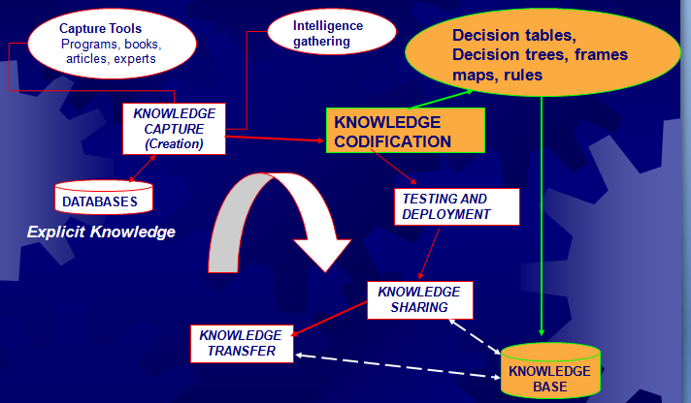
Knowledge Codification in the KM System Life Cycle

Slide 30
Why Codify
Diagnosis—addressing identifiable symptoms of specific causal factors
Instruction/training: promoting training of junior personnel based on captured knowledge of senior employees
Interpretation—promoting training of junior personnel based on captured knowledge of senior employees
Planning/scheduling—mapping out an entire course of action before any steps are taken
Prediction—inferring the likely outcome of a given situation and flashing a proper warning or suggestion for corrective action

Slide 31
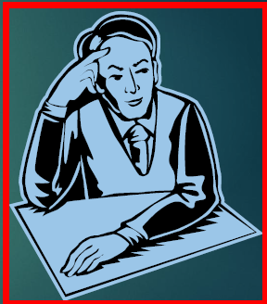
Pre-KC Questions
What organizational goals will the codified knowledge serve?
Why is the knowledge useful?
How would one codify knowledge?

Slide 32
Some Codification Tools
Knowledge Map
Decision Table
Decision Tree
Frames
Production Rules
Case-based Reasoning

Slide 33
Knowledge Map
Visual representation of knowledge, not a repository
Identify strengths to exploit and missing knowledge gaps to fill
Can be applied in Knowledge Capture
A straightforward directory that points people to where they can find certain expertise
Capture both explicit and tacit knowledge in documents and in experts’ heads

Slide 34
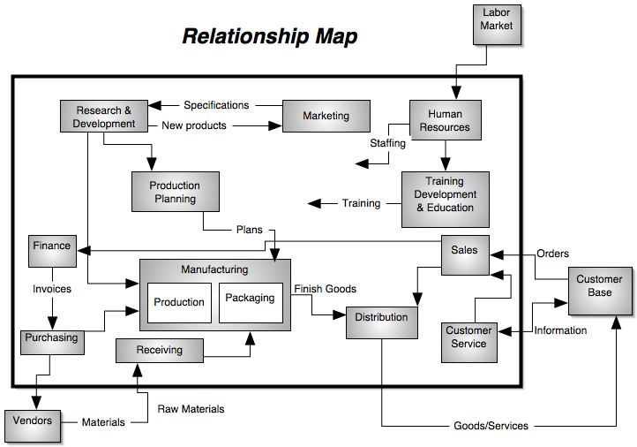
Knowledge Map (Relationship among Departments)

Slide 35
The Building Cycle
Once where knowledge resides is known, simply point to it and add instructions on how to get there
An intranet is a common medium for publishing knowledge maps
Main criteria: clarity of purpose, ease of use, accuracy and currency of content

Slide 36
Decision Trees
Composed of nodes representing goals and links representing decisions or outcomes
All nodes except the root node are instances of the primary goal. (See next figure)
Often a step before actual codification
Ability to verify logic graphically in problems involving complex situations that result in a limited number of actions

Slide 37
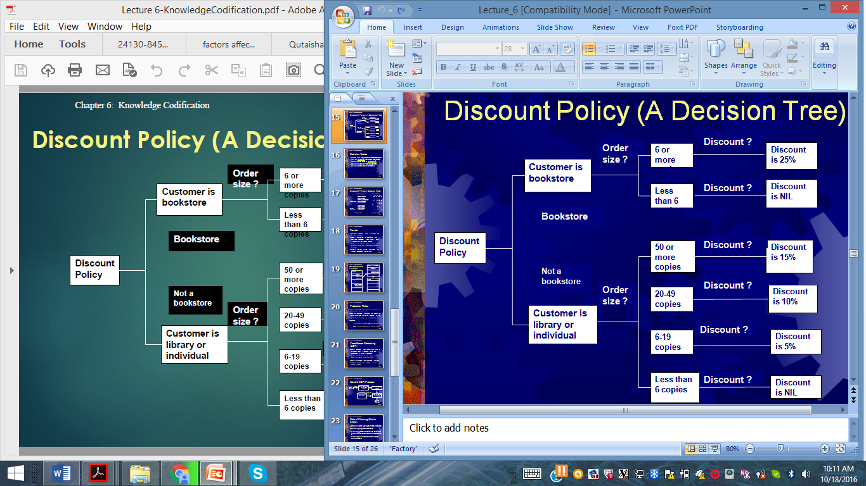
Discount Policy (A Decision Tree)

Slide 38
Decision Tables
More like a spreadsheet—divided into a list of conditions and their respective values and a list of conclusions
Conditions are matched against conclusions (See next table)

Slide 39
Discount Policy (A Decision Table)
Condition Stub
Condition Entry
1 2 3 4 5 6
Customer is bookstore
Order size > 6 copies
Customer is librarian/individual
IF Order size 50 copies or more
(condition) Order size 20-49 copies
Order size 6-19 copies
Y Y N N N N
Y N N N N N
Y Y Y Y
Y N N N
Y N N
Y N
Allow 25% discount
Allow 15% discount
Allow 10% discount
THEN Allow 5% discount
(action) Allow no discount
X
X
X
X
X X
Action Stub
Action Entry

Slide 40
Frames
Represent knowledge about a particular idea in a data structure
Handle a combination of declarative and operational knowledge, which make it easier to understand the problem domain
Have a slot (a specific object or an attribute of an entity) and a facet (the value of an object or a slot)
When all the slots are filled with values, the frame is considered instantiated

Slide 41
An Automobile Example
Generic COUPE Frame
Specialization: AUTOMOBILE
Generalization: (SMITH’S AUTOMOBILE, HANSON’S AUTOMOBILE)
Doors: 2
Generic AUTOMOBILE Frame
Specialization: VEHICLE
Generalization: (STATION-WAGON, COUPE, SEDAN)
. . .
Year: Range: (1940 – 1990) If-Changed: (ERROR: Value cannot be modified)
. . .
SMITH’S AUTOMOBILE Frame
Specialization: COUPE
. . .
Year: 1990
Doors: ( )

Slide 42
Production Rules
Tacit knowledge codification in the form of premise-action pairs
Rules are conditional statement that specify an action to be taken if a certain condition is true
The form is IF… THEN, or IF…THEN…ELSE
Example:
IF income is “average” and pay history is “good”
THEN recommendation is “approve loan”

Slide 43
Case-Based Reasoning (CBR)
CBR is reasoning from relevant past cases in a manner similar to humans’ use of past experiences to arrive at conclusions
Goal is to bring up the most similar historical cases that match the current case
More time savings than rule-based systems
Requires rigorous initial planning of all possible variables

Slide 44
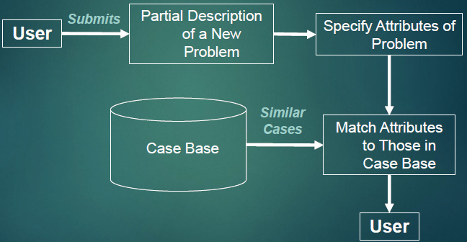
Generic CBR Process

